Slide 1
5
Business Intelligence

Slide 2
Managers and Decision Making
What Is Business Intelligence?
Business Intelligence Applications for Data Analysis
Business Intelligence Applications for Presenting Results

Slide 3
Identify the phases in the decision-making process, and use a decision support framework to demonstrate how technology supports managerial decision making.
Describe and provide examples of different ways that organizations use business intelligence (BI).

Slide 4
Specify the BI application available to users for data analysis, and provide examples of how each application can be used to solve a business problem at your university.
Describe three BI applications that present the results of data analyses to users, and offer examples of how

Slide 5

How Much Rent Can You Charge?
What additional sources of data could RentRange collect to enhance its predictive accuracy? Provide examples to support your answer.
What other companies or institutions could utilize RentRange’s predictions?
PP. 140-14

Slide 6
Renting out single-family homes was largely a mom-and-pop business until the U.S. housing bust (roughly from 2006 until 2012). In the aftermath of the bust, large investment firms began investing substantial sums of money in this market. For example, Blackstone Group.
RentRange provides analyses about purchasing foreclosed and low-priced single-family homes and then renting them out. Using data from 12 million properties around the United States, RentRange can estimate how much monthly rent a property is likely to generate. Such predictive analyses provide critical input into the financial models that investors use to determine where to buy homes to convert to rentals, as well as how much rent they can charge.
RentRange in 2008, used his own money to purchase data from property managers, rental listing Web sites, and landlords. To predict a likely rent, RentRange’s predictive algorithms integrate those raw data with additional data, such as whether dogs or smoking have been, and are, allowed and whether the local area is already saturated with rental homes.

Slide 7
Customers pay $50,000 for 5 years of RentRange data at regional, county, city, and zip code levels to help identify potentially profitable markets. Once investors pick a market, they pay $2 to $12 for rental estimates for specific properties.
According to the Goldman Sachs Group (www.goldmansachs.com). As a result, it is not clear how long the buy-to-rent boom will last, as rising home prices make the process less profitable.
If the buy-to-rent market does lose momentum, then Rent-Range has other customers to fall back on. For example, some credit card companies have begun using RentRange’s predictions to evaluate applicants’ creditworthiness.

Slide 8
Business intelligence
BI is a broad category of applications, technologies, and processes for gathering, storing, accessing, and analyzing data to help business users make better decisions.
BI applications enable decision makers to quickly ascertain the status of a business enterprise by examining key information.
Example: Large firms that want to invest in single family homes to rent need current, timely, and accurate information to predict the rents they can charge to maximize their return on investment (ROI).
The essential goal of information systems is to provide the right information to the right person, in the right amount, at the right time, in the right format.
In essence, BI achieves this goal. BI systems provide business intelligence that you can act on in a timely fashion.

Slide 9
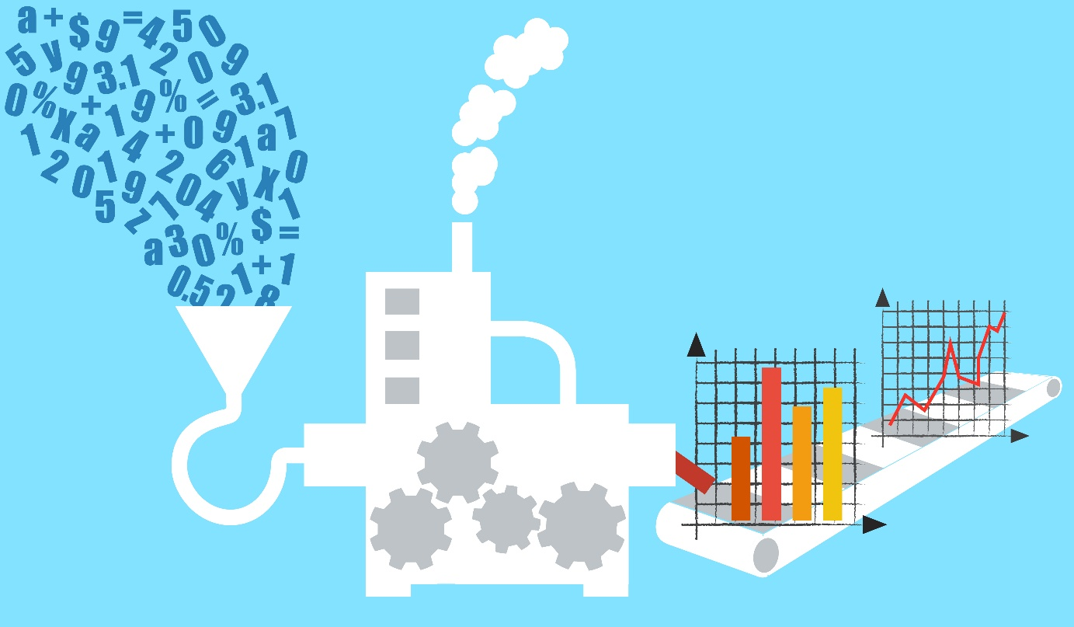
What key points have we learned from the opening case?
Data
Algorithm
Use
Effect
New use
Notes:
Management: a process by which an organization achieves its goals through the use of resources (people, money, materials, and information).
Three Basic Roles of Managers (Mintzberg, 1973):
1. Interpersonal roles: fi gurehead, leader, liaison
2. Informational roles: monitor, disseminator, spokesperson, analyzer
3. Decisional roles: entrepreneur, disturbance handler, resource allocator, negotiator

Slide 10
5.1
Managers and Decision Making
The Manager’s Job and Decision Making
Why Managers Need IT Support?
What Information Technologies are Available to Support Managers
A Framework for Computerized Decision Analysis

Slide 11
Managers and Decision Making
Management is a process by which an organization achieves its goals through the use of resources (people, money, materials, and information). These resources are considered to be inputs.
Achieving the organization’s goals is the output of the process. Managers oversee this process in an attempt to optimize it.
A manager’s success often is measured by the ratio between the inputs and outputs for which he or she is responsible. This ratio is an indication of the organization’s productivity.
A decision refers to a choice among two or more alternatives that individuals and groups make. Decisions are diverse and are made continuously. Decision making is a systematic process.
Economist Herbert Simon (1977)2 described decision making as composed of three major phases: intelligence, design, and choice.

Slide 12

The Manager’s Job and Decision Making
Management
Three Basic Roles of Managers
Interpersonal
Informational
decisional
Four Phases of Decision Making
➔ ➔ ➔
Notes:
Management: a process by which an organization achieves its goals through the use of resources (people, money, materials, and information).
Three Basic Roles of Managers (Mintzberg, 1973):
1. Interpersonal roles: fi gurehead, leader, liaison
2. Informational roles: monitor, disseminator, spokesperson, analyzer
3. Decisional roles: entrepreneur, disturbance handler, resource allocator, negotiator

Slide 13
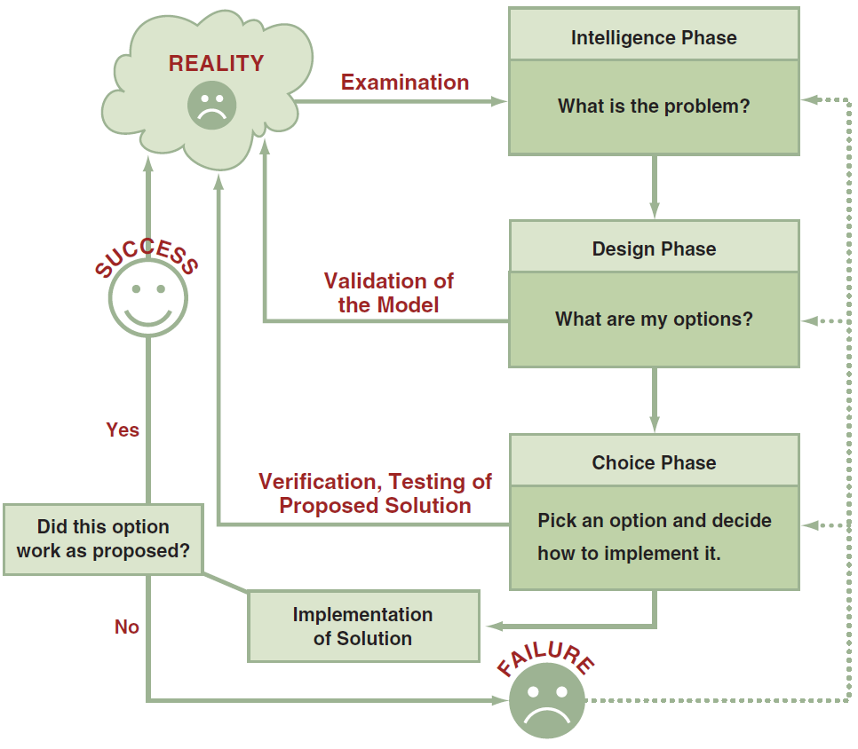
The Process and Phases in Decision Making
Notes:
Decision: a choice among two or more alternatives that individuals and groups make. Decisions are diverse and are made continuously.
Phases of the Decision Making Process:
Intelligence Phase: managers examine a situation and then identify and defi ne the problem or opportunity.
Design Phase: decision makers construct a model for addressing the situation. They perform this task by making assumptions that simplify reality and by expressing the relationships among all of the relevant variables. Managers then validate the model by using test data. Finally, decision makers set criteria for evaluating all of the potential solutions that are proposed.
Choice Phase: involves selecting a solution or course of action that seems best suited to resolve the problem. Th is solution (the decision) is then implemented.
Implementation Phase: is successful if the proposed solution solves the problem or seizes the opportunity. If the solution fails, then the process returns to the previous phases. Computer-based decision support assists managers in the decision-making process.

Slide 14
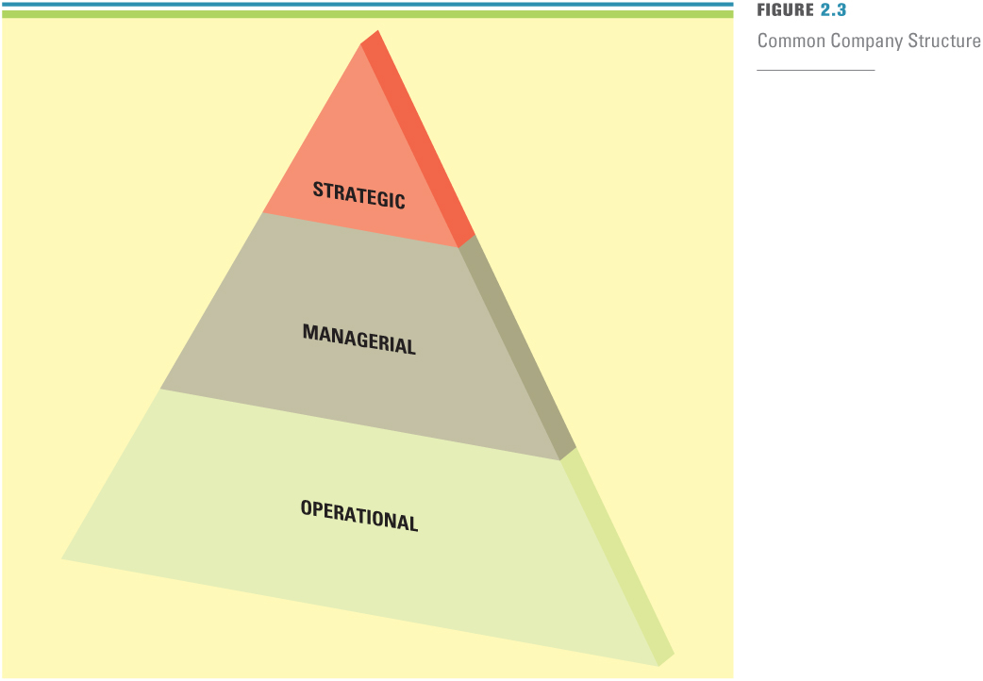
DECISION-MAKING ESSENTIALS
Decision-making and problem-solving occur at each level in an organization

Slide 15
Why Managers Need IT Support?
The number of alternatives is constantly increasing
Most decisions are made under time constraints
Uncertainty in the decision environment
Decisions more complex ⬅ sophisticated analysis needed
Group decision making required
The WebEx collaboration example

Slide 16
What IT are Available to Support Managers
Business Intelligence Tools
discovery, communication, a
nd collaboration tools
Notes:
Business Intelligence (BI): is a broad category of applications, technologies, and processes for gathering, storing, accessing, and analyzing data to help business users make better decisions. BI applications enable decision makers to quickly ascertain the status of a business enterprise by examining key information.

Slide 17
A Framework for Computerized Decision Analysis
Problem Structure
The Nature of Decisions
The Decision Matrix
Computer Support for Structured Decisions
Notes:
Problem Structure: where decision-making processes fall along a continuum ranging from highly structured to highly unstructured.
Nature of Decisions:
All managerial decisions fall into one of three broad categories:
Operational Control: executing specific tasks efficiently and effectively.
Management Control: acquiring and using resources efficiently in accomplishing organizational goals.
Strategic Planning: the long-range goals and policies for growth and resource allocation.

Slide 18
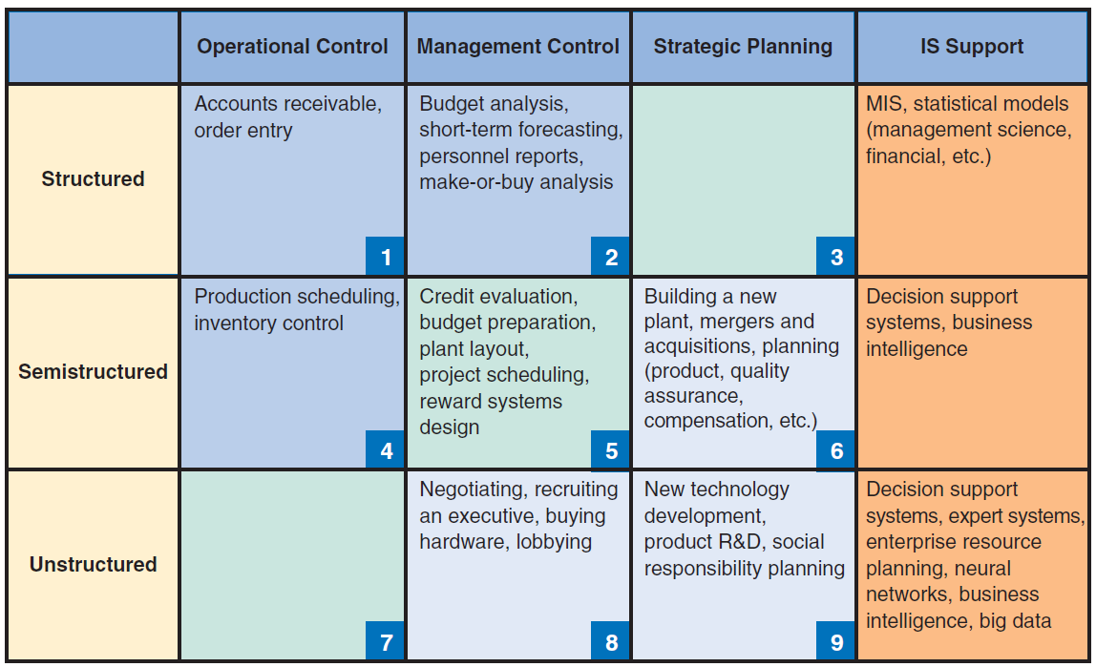
Figure 5.2: Decision Support Framework

Slide 19
Problem Structure & Nature of Decisions
The first dimension deals with the problem structure, where does the decision making processes fall along the continuum ranging from highly structured to highly unstructured decisions.
Structured
Unstructured
Semistructured
The second dimension of decision support deals with the nature of decisions
Operational control
Management control
Strategic planning
Notes:
Structured problems are routine and repetitive problems for which standard solutions exist.
Unstructured problems are fuzzy, complex problems for which there are no cut-and-dried
solutions.
Semistructured problems are problems in which only some of the decision process phases
are structured.

Slide 20
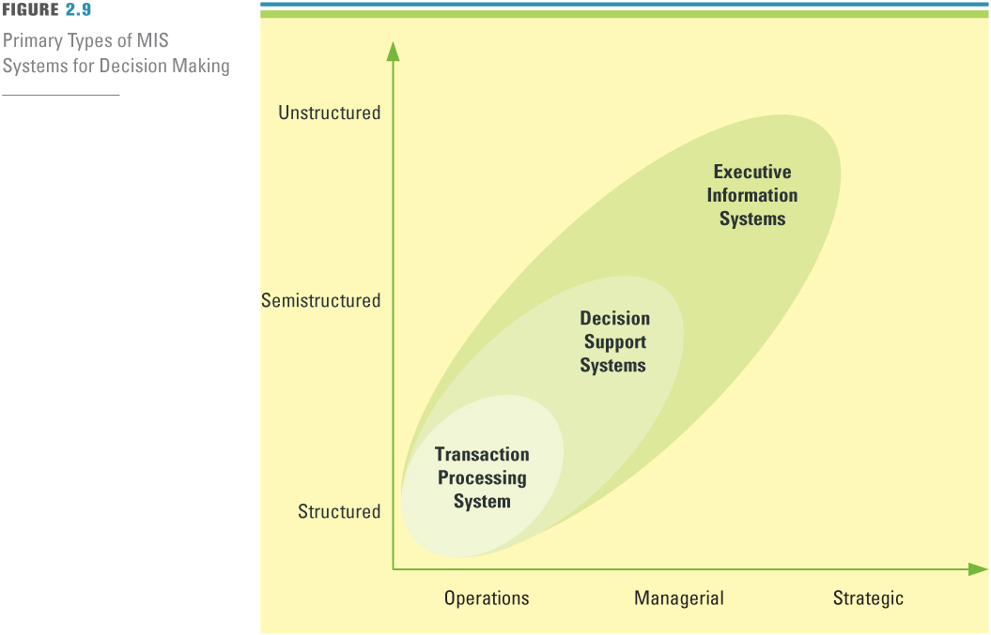
SUPPORT: ENHANCING DECISION MAKING WITH MIS
Types of Decision Making MIS Systems

Slide 21
5.2
What is Business Intelligence?
The Scope of Business Intelligence
The three specifi c BI targets that represent different levels of change:
The Development of One or a Few Related BI Applications
The Development of Infrastructure to Support Enterprise-wide BI
Support for the Organizational Transformation
Notes:
Business Intelligence (BI): is a broad category of applications, technologies, and processes for gathering, storing, accessing, and analyzing data to help business users make better decisions. BI applications enable decision makers to quickly ascertain the status of a business enterprise by examining key information.

Slide 22
’S ABOUT BUSINESS 5.1
Predicting Airplane Arrivals More Accurately
Do you think that satellite-based navigation will meet resistance among air traffic controllers? Why or why not?
Do you think that pilots will object to having “smart assistants” help them make decisions? Why or why not?
Do you think the overall response of the airlines to satellite-based navigation and smart assistants for pilots will be positive or negative? Support your answer.
What is the relationship between analytics and smart assistants for pilots?

Slide 23

’S ABOUT BUSINESS 5.2
Cardlytics Analyzes Customer Buying Behaviors
Discuss the advantages and disadvantages of Cardlytics’s data analyses for the customer. Use specific examples in your answers.

Slide 24
5.3
Business Intelligence Applications for Data Analysis
Multidimensional Analysis or Online Analytical Processing
Data Mining
Decision Support Systems

Slide 25
Multidimensional Analysis or Online Analytical Processing
Online Analytical Processing
Data warehousing
Multi-dimensional Analysis
“slicing and dicing”
Notes:
Online Analytical Processing (OLAP - also referred to as multidimensional analysis) capabilities. OLAP involves “slicing and dicing” data stored in a dimensional format, drilling down in the data to greater detail, and aggregating the data.

Slide 26
Data Mining
Two Basic Data Mining Operations
Predicting trends and behaviors
Identifying previously unknown patterns
Fraud detection: DiscoverCard
Basket analysis: The parable of the beer and diapers
Notes:
Data Mining: the process of searching for valuable business information in a large database, data warehouse, or data mart.
Data Mining Can Perform Two Basic Operations:
(1) predicting trends and behaviors
(2) identifying previously unknown patterns.
Beer and diaper: Osco Drug stores - 1.2 million baskets

Slide 27
Decision Support Systems (DSS)
Sensitivity Analysis
Example: How “robust” or stable the solution would be in optimization
What-If Analysis
We’ve just learned it and done it!
Goal-Seeking Analysis
Notes:
Decision support systems (DSSs): combine models and data to analyze semistructured problems and some unstructured problems that involve extensive user involvement. Models are simplified representations, or abstractions, of reality.
Sensitivity Analysis: Sensitivity analysis is the study of the impact that changes in one or more parts of a decision-making model have on other parts.
What–If Analysis: A model builder must make predictions and assumptions regarding the input data, many of which are based on the assessment of uncertain futures. The results depend on the accuracy of these assumptions, which can be highly subjective.
Goal-Seeking Analysis: represents a “backward” solution approach. It attempts to calculate the value of the inputs necessary to achieve a desired level of output.

Slide 28
Decision Support Systems (DSS)
Decision support systems
combine models and data
in an attempt to solve semistructured and unstructured problems
with extensive user involvement (interaction， “dialog”)
Notes:
Decision support systems (DSSs) are computer-based information systems that
combine models and data in an attempt to solve semistructured and some unstructured
problems with extensive user involvement.
Sensitivity analysis is the study of the impact that changes in one (or more) parts of a model
have on other parts.
What-if analysis is the study of the impact of a change in the assumptions (input data) on the
proposed solution.
Goal-seeking analysis is the study that attempts to find the value of the inputs necessary to
achieve a desired level of output.

Slide 29

SUPPORT: ENHANCING DECISION MAKING
Model – A simplified representation or abstraction of reality
Models help managers to
Calculate risks
Understand uncertainty
Change variables
to explore…
Manipulate time to make decisions
Benefits:

Slide 30
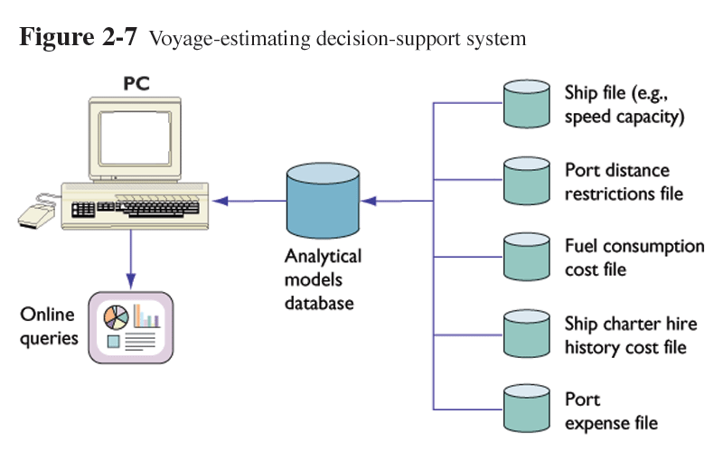
Decision Support System (DSS) [Laudon]

Slide 31
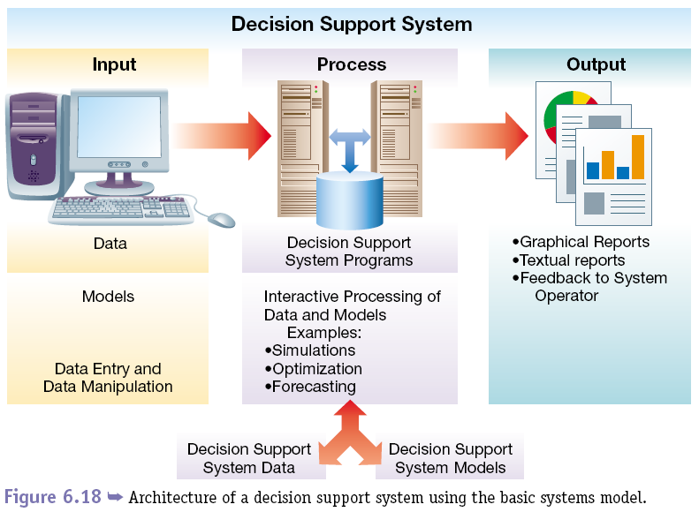
System Architecture: DSS [Jessup&Valacich, edited by Zhang]
**
Simulations
Optimization
Forecasting

Slide 32
5.4
Business Intelligence Applications for Presenting Results
Dashboards
Data Visualization Technologies
Real-Time BI
Notes:
Dashboard: provides easy access to timely information and direct access to management reports. They evolved from executive information systems, which were information systems designed specifically for the information needs of top executives
Data Visualization: data presented to users in visual formats such as text, graphics, and tables following data processing. Data Visualization makes IT applications more attractive and understandable to users.
Real-Time Business Intelligence: includes the use of real time data for analysis as it is created rather than using historical data for analysis.

Slide 33
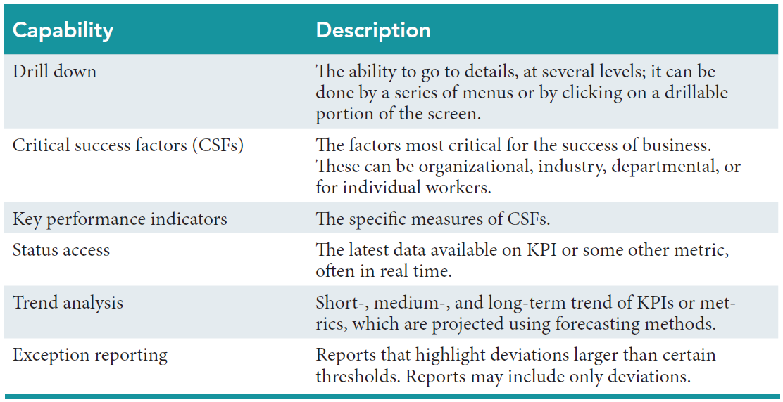
Table 5.1: The Capabilities of Dashboards

Slide 34
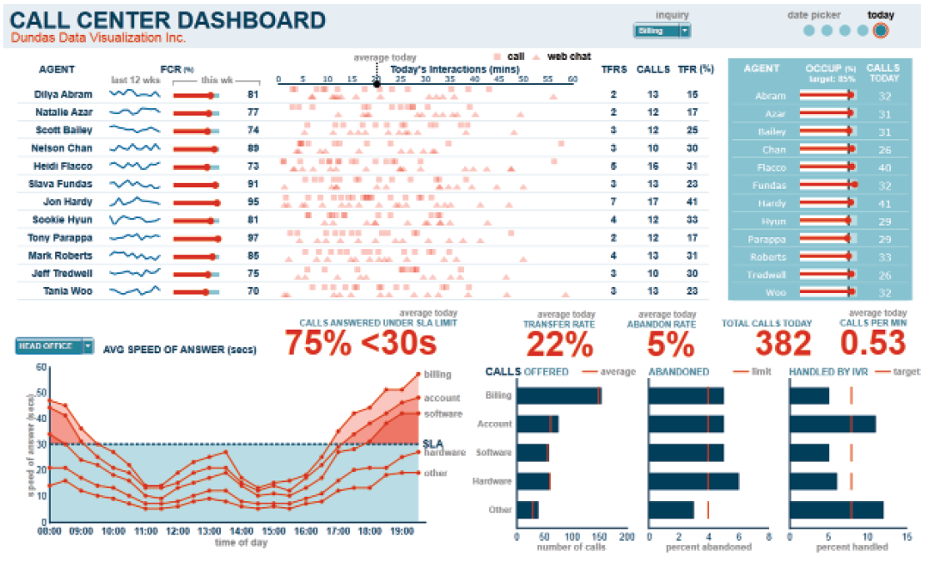
Figure 5.3: Sample Performance Dashboard

Slide 35
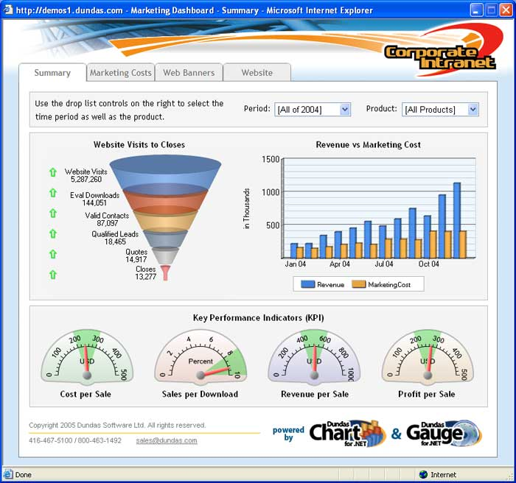
Sample Performance Dashboard

Slide 36
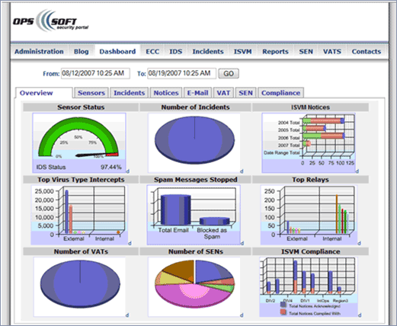
Another Example of Dashboard

Slide 37
Executive Dashboard Demo
http://www.informationbuilders.com/rfr/qtdemo/AdvVis_ExecDash/AdvVis_ExecDash.html

Slide 38
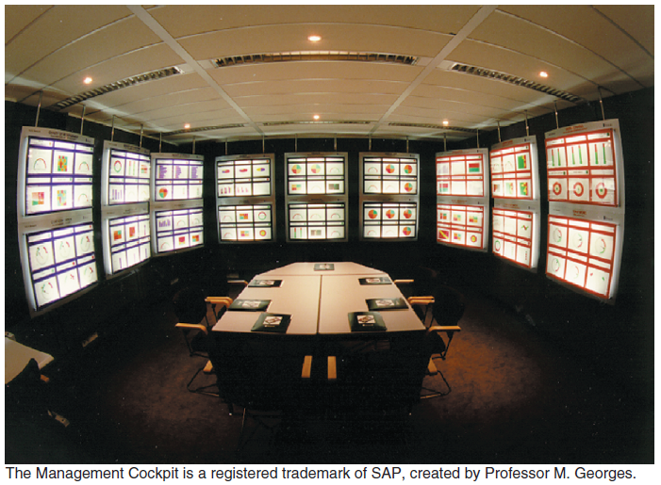
Figure 5.5: Management Cockpit

Slide 39
Data Visualization Technologies
Geographic Information Systems
Reality Mining
Notes:
Geographic Information System (GIS): a computer-based system for capturing, integrating, manipulating, and displaying data using digitized maps. Its most distinguishing characteristic is that every record or digital object has an identified geographical location.
Reality Mining: Graphical Information Systems (GIS) and Geographic Positioning Systems (GPS) together to produce an interesting new type of technology which allows analysts to extract information from the usage patterns of mobile phones and other wireless devices.

Slide 40
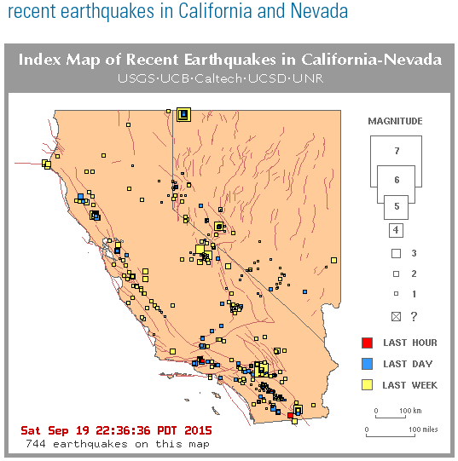
GIS in Action (1): CA Earthquakes

Slide 41
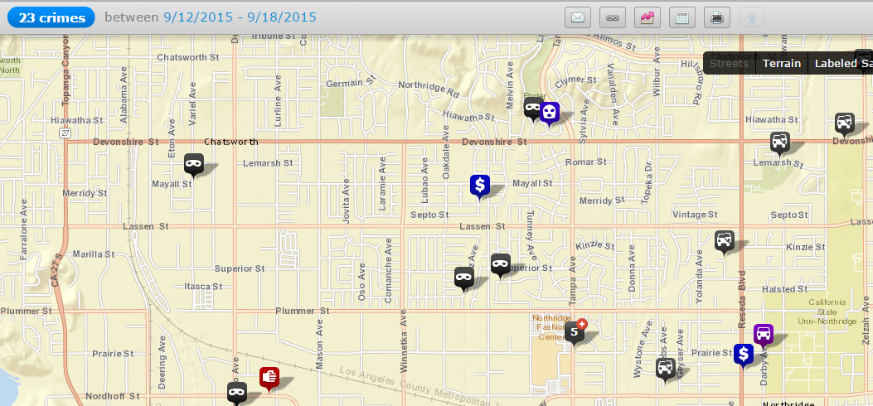
GIS in Action (2): crimemapping.com

Slide 42
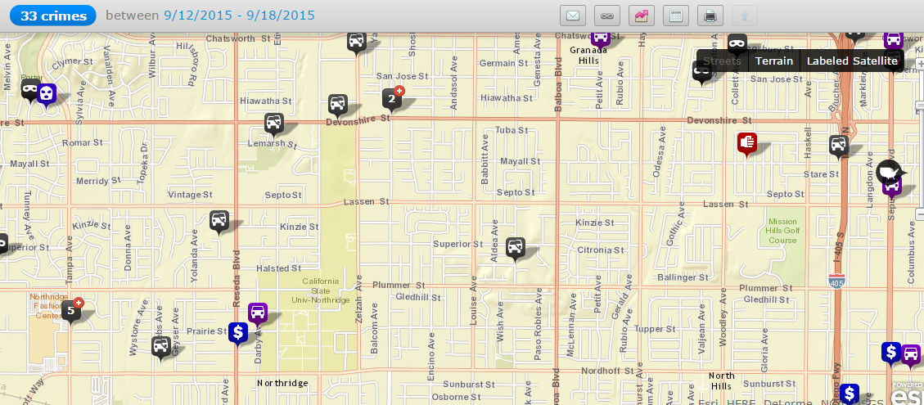
GIS in Action (2): crimemapping.com

Slide 43
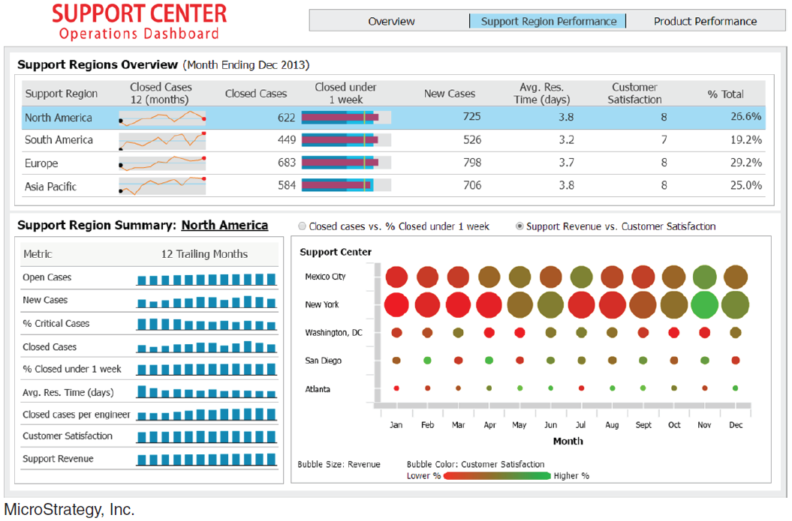
Figure 5.6: Support Center Operations Dashboard

Slide 44
Data visualization: Hans Rosling
The Best Stats You've Ever Seen | Hans Rosling | TED Talks
(Suggest: Beginning from 3:00’)
How Not to Be Ignorant About the World | Hans and Ola Rosling

Slide 45

’S ABOUT BUSINESS 5.3
Geographic Information Systems Have Many Uses
Describe how your university might use GIS. Provide specific examples in your answer.
What are potential disadvantages of GIS? Provide specific examples in your answer.

Slide 46
The Business Problem ConocoPhillips (CP) (www.conocophillips.com) is a $9 billion U.S. multinational energy corporation. It is the world’s largest independent energy exploration and production company. The company explores for, produces, transports, and markets crude oil and natural gas on a worldwide basis.
Finding oil and gas is a first step for CP.
The next step is to invest millions of dollars to drill each well to extract those resources.
The company must then spend additional money to manage the natural decline in production at each well. With returns and profitability directly linked to production, CP must try to extract every barrel of oil or cubit foot of gas it can from its wells.

Slide 47
There is nothing new about energy companies using analytics to find and produce more oil and gas. An excellent example of analytics at work in the energy industry is the custom developed plunger lift surveillance and optimization software tool (PLOT) from CP. PLOT enables the company to optimize a well to its true capacity.

